Slide 1
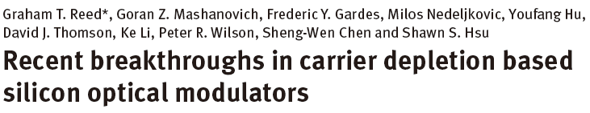
Paper Review
Nanophotonics, 2014
Introduction
Performance metrics of modulators
Design of modulators
Current research trend
Conclusion

Slide 2

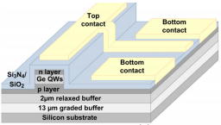
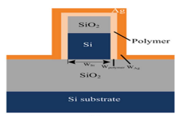
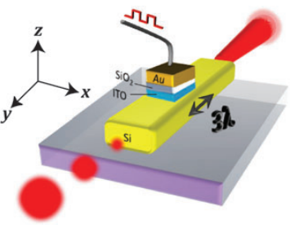
Silicon Optical Modulators
Various mechanisms for high performance
-III-V material
-Germanium
-Polymers
-Graphene
-Plasmonic based approach
<III-V material>
<Germanium>
<Polymer>
<Plasmonic>

Slide 3
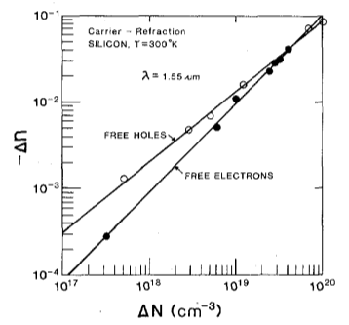
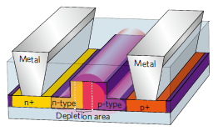
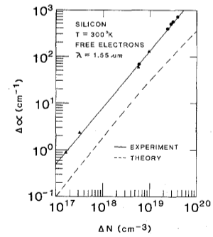

Carrier Depletion Based Modulator
<Carrier depletion modulator>
<Refractive index vs Carrier concentration>
Plasma dispersion effect
-Change in carrier concentration
➔change in refractive index, absorption coefficient
➔change in phase & intensity
$$∆n=−[8.8×{10}^{−22}∆N_{e}+8.5×{10}^{−18}{\left(∆N_{h}\right)}^{0.8}]$$
$$∆α=6×{10}^{−18}∆N_{e}+4×{10}^{−18}∆N_{h}]$$
<Loss vs Carrier concentration>
Ref. “Electrooptical Effects in Silicon”, Soref and Bennett, IEEE J. of Quantum Electronics, 1987

Slide 4
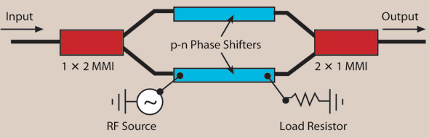
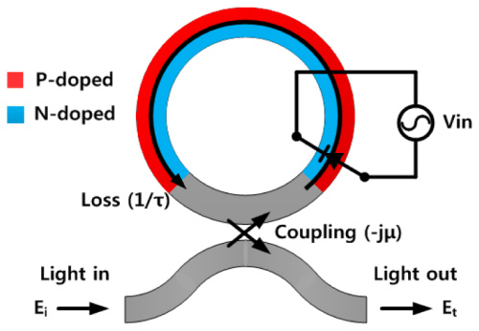
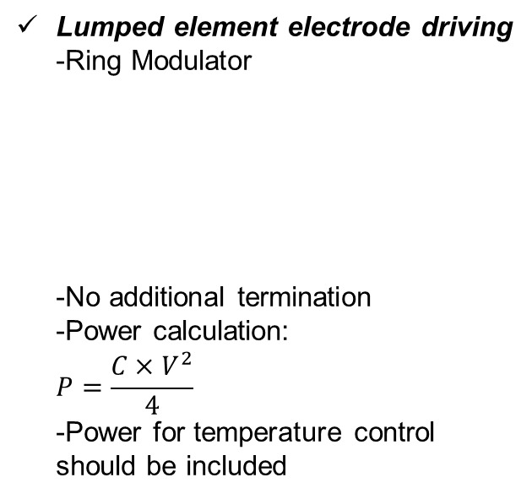
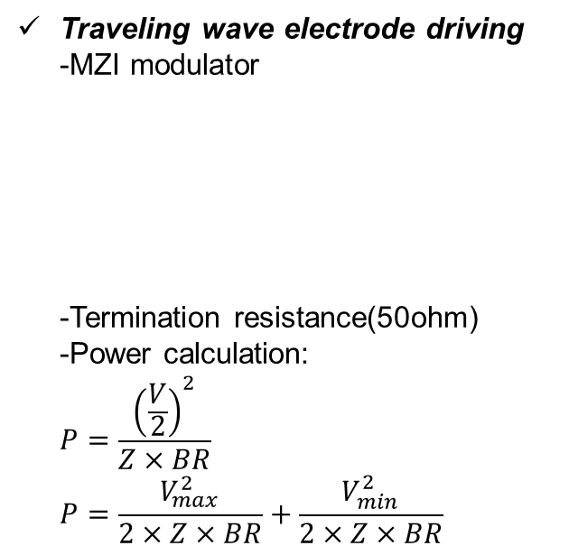
Performance Metrics (I)
Modulator drive voltage/power consumption
-Energy consumed per bit of data ex)10pJ/bit
-Two different ways to calculate
Traveling wave electrode driving
-MZI modulator
-Termination resistance(50ohm)
-Power calculation:
$P=\frac{{\left(\frac{V}{2}\right)}^{2}}{Z×BR}$
$P=\frac{V_{max}^{2}}{2×Z×BR}+\frac{V_{min}^{2}}{2×Z×BR}$
Lumped element electrode driving
-Ring Modulator
-No additional termination
-Power calculation:
$P=\frac{C×V^{2}}{4}$
-Power for temperature control
should be included

Slide 5
Performance Metrics (II)
Loss
-Loss per unit length
Speed
-Mostly governed by its RC time constant
Phase efficiency
-Phase shift produced for a given length(V∙cm)
Extinction ratio
-Difference in optical output between 1 and 0 levels
Footprint
-Arm length(MZM), radius(Ring modulator)
Optical bandwidth
-Band of wavelength for operation
Temperature sensitivity
Chirp

Slide 6
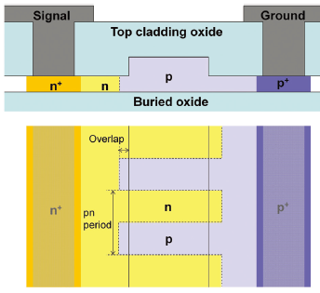
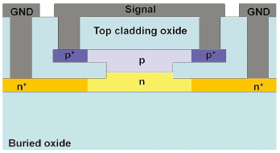
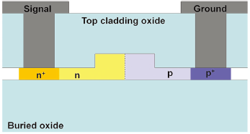
Categories Of Modulators
Three types of modulator
-Vertical junction
-Horizontal junction
-Interleaved junction
<Vertical Junction>
<Horizontal Junction>
<Interleaved Junction>

Slide 7
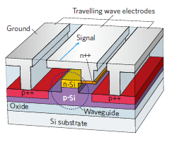
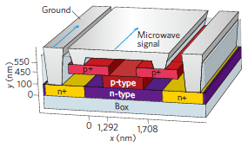

Vertical Type Modulator
<First proposed structure>
<Wide bandwidth structure>
First purposed structure: tens of GHz BW
Wide BW structure: 40-Gpbs modulation with 1dB extinction ratio
4 V$∙$cm phase efficiency, 1.8dB/cm loss

Slide 8
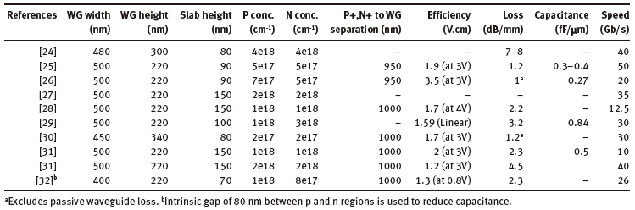
Horizontal Type Modulator
Numerous versions of modulators
-Rib waveguide geometry
-Doping concentration and positioning of different doped regions
-Design of electrode
-Position of pn junction

Slide 9
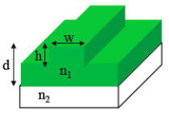
Waveguide Geometry
Single mode support
-Avoid performance degradation with only single mode
TE & TM mode support if necessary
-Same index and loss for both TE & TM fundamental modes
Optical confinement
-Phase efficiency
-Optical loss
Height of slab
-Thick slab ➔ low resistance ➔ Higher BW
➔ high loss
<Rib waveguide geometry>

Slide 10
Doping Concentration
Distance(D)
-Small D ➔ small resistance ➔ higher BW
➔ higher loss
Doping concentration
-Highly doped region: high doping preferred for ohmic contact(small resistance)
-Low doped region
High doping ➔ small resistance, high capacitance ➔ RC time ???
➔ higher phase efficiency
➔ increased absorption loss
D
<Cross section of horizontal type modulator>

Slide 11
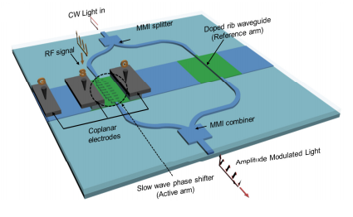
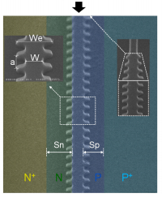
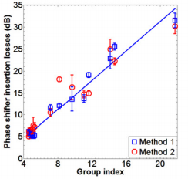
Design of Electrode
Impedance should be matched
-50ohm matching
Velocity of electrical signal and light should be matched
-Slow light increase insertion loss
Ref. “High speed silicon electro-optical modulators enhanced via slow light propagation”
, A. Brimont, et al., Optics Express, 2011
<Implementation of slow wave>
<Structure of arm>
<Insertion loss vs Group index>

Slide 12
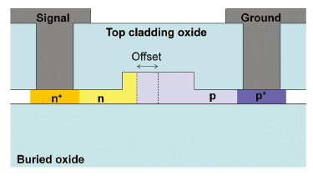
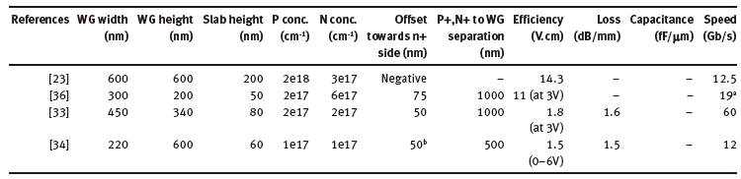
Position of PN Junction
Offset of junction location
-P-type has larger refractive index change
(Soref & Bennett equation)
-Large portion of P-type
➔Increased efficiency
<Cross section of modulator>

Slide 13
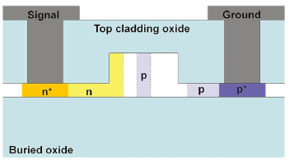
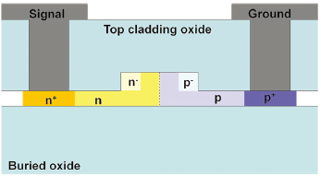
Junction Optimization
<Device by Marris-Morini>
<Device by Tu>
Different contribution region
-Modulation efficiency: depletion region
-Optical loss: doped region
➔Doping localization can improve performance
Device by Marris-Morini: 1dB/mm loss, 3.5V.cm reported
Device by Tu: <1dB/mm loss, 2.67V.cm, 50-Gbps reported

Slide 14
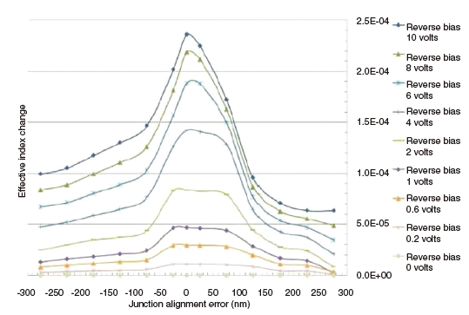
Junction Misalignment
<Effective index change vs Junction misalignment>
Junction misalignment due to fabrication error
-Phase efficiency reduced by 40% with only 50nm misalignment

Slide 15
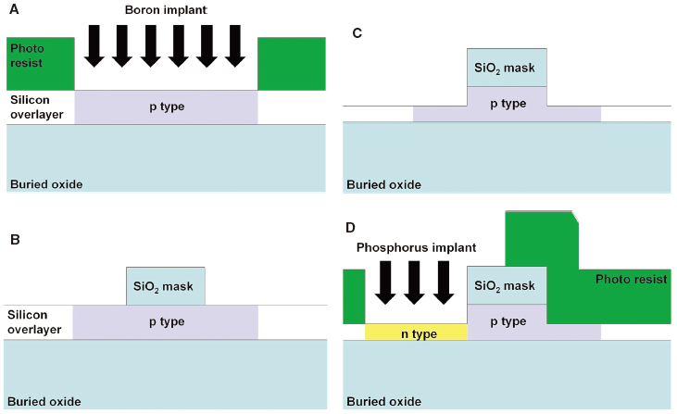
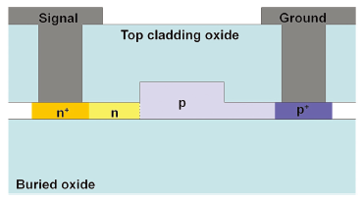
Self-aligned PN Junction Formation
<Self-aligned modulator>
<Process of self-alignment>
Simple process
-Junction location is robust to fabrication error
-2.3V.cm efficiency is reported

Slide 16
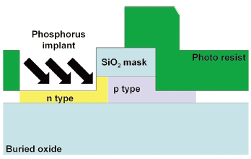
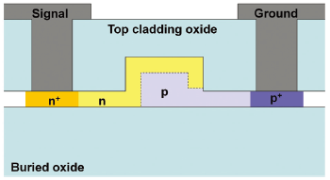
Angled Implantation
<Process of angled implantation>
<Modulator with modified angled implantation>
Additional simple process
-Place junction inside rib waveguide
-Different junction section of N-type doping
➔Allows more degrees of freedom for phase modulation
➔Fundamental TE/TM mode modulation

Slide 17
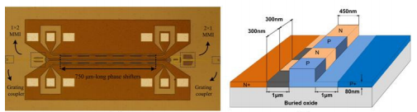
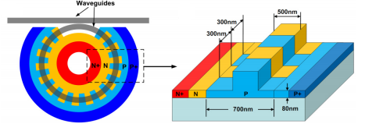
Interleaved Type Modulator
Density of depletion increase
-Period of p,n region should be small
-Increase in capacitance
➔Lower BW, more power
-Tolerant to alignment errors
MZM
-44-Gbps, 1.7V.cm efficiency
1dB/mm loss is reported
Ring modulator
-25-Gbps, 1.4V.cm efficiency
1.7dB/mm loss is reported
<MZM with interleaved junction>
<Ring modulator with interleaved junction>

Slide 18
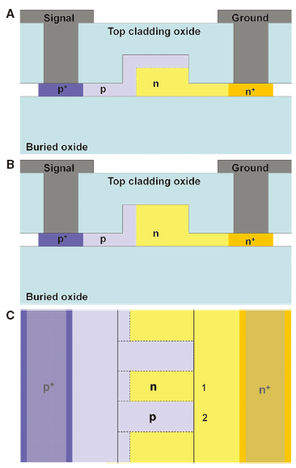
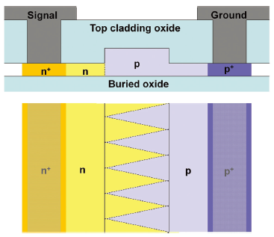
Further Approach
<Zigzag shape doping>
<Combination of 3-types junction>
Zigzag shape junction
-Reduce capacitance than interleaved junction
Combination of 3-types junction
-0.84V.cm efficiency, 3.5dB/mm loss, 40-Gbps data rate

Slide 19

Long Haul Applications
Higher extinction ratio required
-Excess 13dB ER is commercialized
Chirp is problematic
-LiNbO₃ MZM have zero chirp
(Using two arms synchronized, dual-drive)
-Silicon MZM is impossible to have zero chirp
Use of more complex modulation format
-DPSK, QPSK, DQPSK, PDM-QPSK, PAM16
<Commercial MZM product>

Slide 20
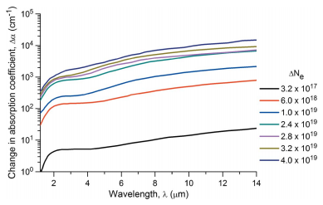
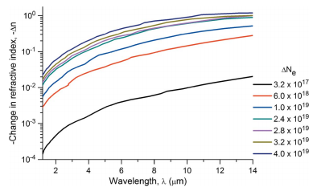
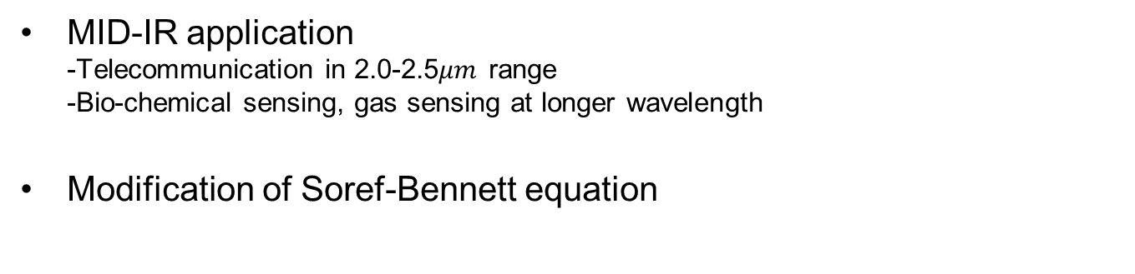


MID-IR Applications
MID-IR application
-Telecommunication in 2.0-2.5$μm$ range
-Bio-chemical sensing, gas sensing at longer wavelength
Modification of Soref-Bennett equation
<$∆α$ vs Wavelength for electron>
<$∆n$ vs Wavelength for electron>

Slide 21
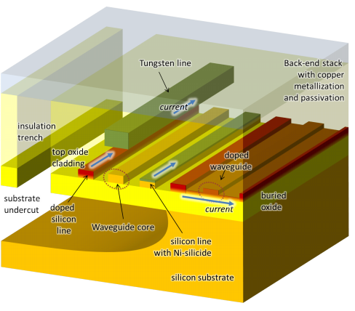
Short Reach Links
Power consumption issue
-Traveling wave electrode has drawback
-146fJ/bit power consumption is reported
Ring or disk resonator for low-power
-Lumped element ➔ no termination needed
-Thermal control block is added
<Different heater architecture in silicon platform>

Slide 22
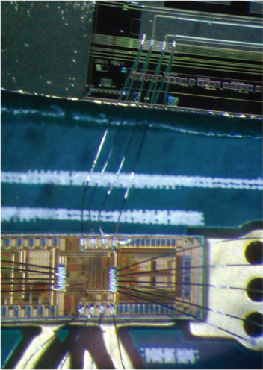
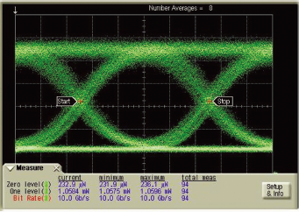
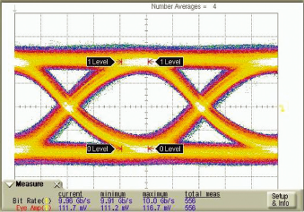
Integration of Silicon Photonics
Co-fabrication of electronics and photonics
-High per-area cost
-relatively large
-complex
Wire bonded approach for low speed
-10-Gbps is reported with 9.8dB ER
<Wire bonded modulator and CMOS driver>
<Eye diagram of hybrid integrated transmitter>
<Eye diagram of hybrid integrated receiver>

Slide 23
Conclusion
Three types of carrier depletion based modulator demonstrated
Design considerations in horizontal type modulator
-Waveguide geometry
-Doping concentration
-Electrode
-Junction location
Further modulators other than three types of modulators
Applications

