Slide 1
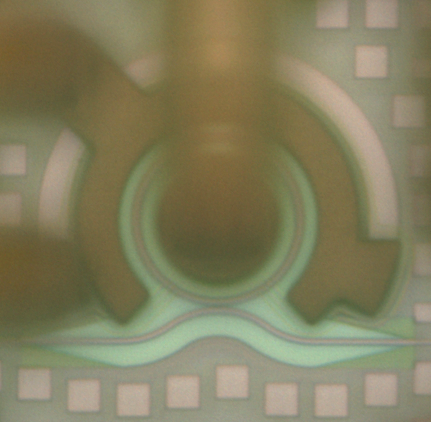

Micro Ring Modulator
2.5mm
20μm
Small size, low power consumption
But very sensitive

Slide 2
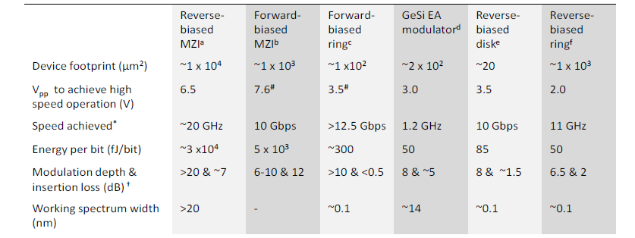
Comparison
(Po Dong ,OPTICS EXPRESS 2009)

Slide 3
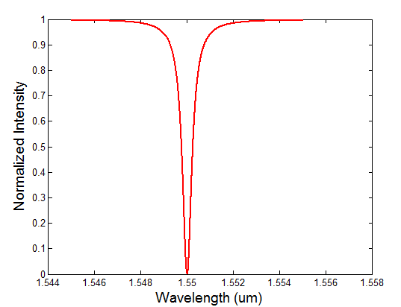
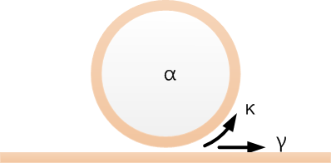
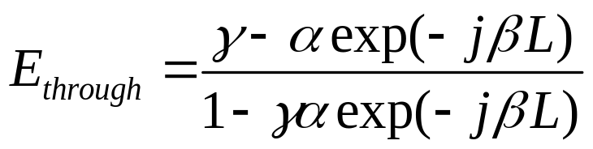
Ring resonator
Wavelength selective device
Sharp drop near resonance

Slide 4
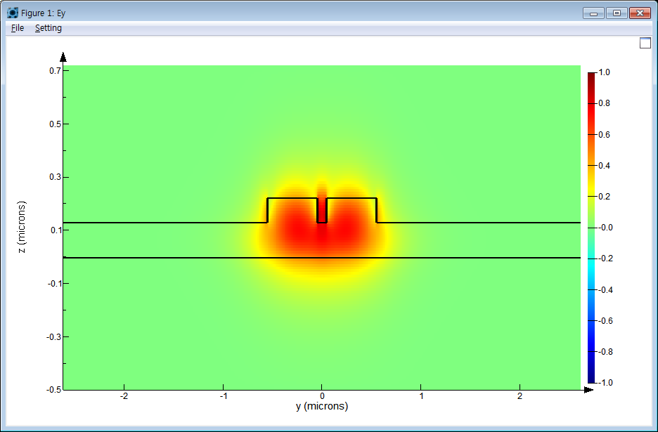
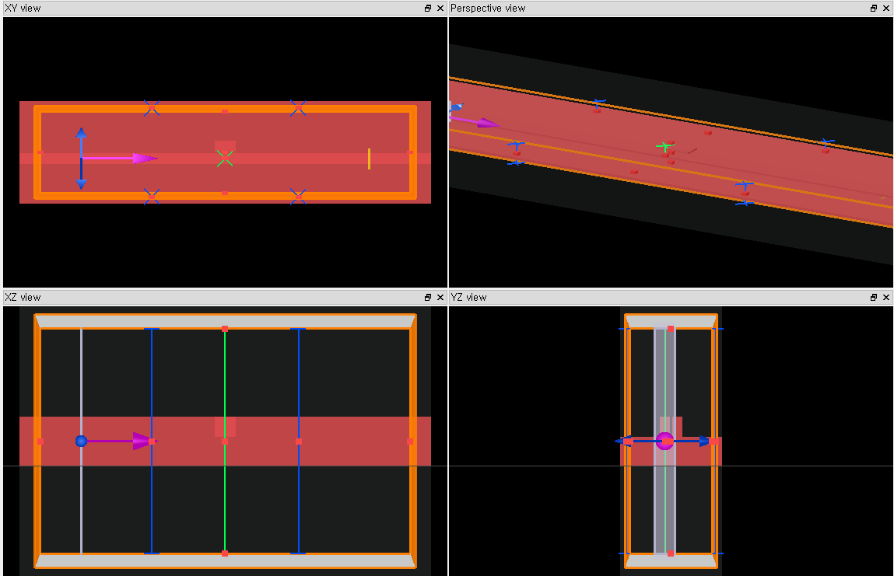
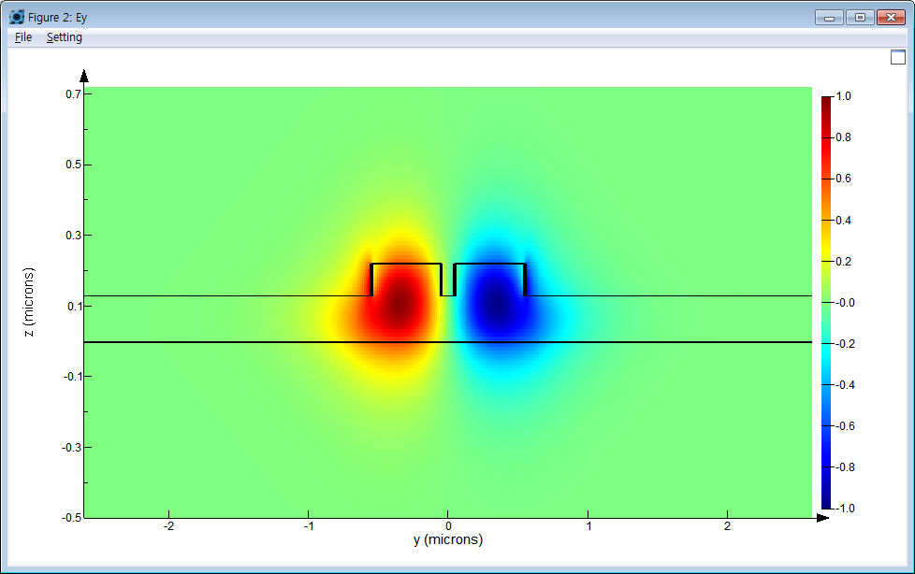
Simulation
α, γ ,n_{eff} can be calculated

Slide 5
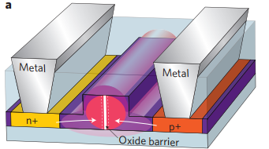
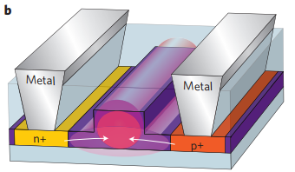
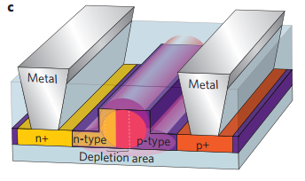
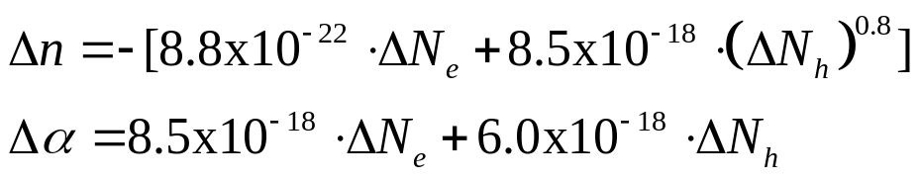
Ring modulator
Type of electro optic modulator
Carrier accumulation
Carrier injection
Carrier depletion

Slide 6
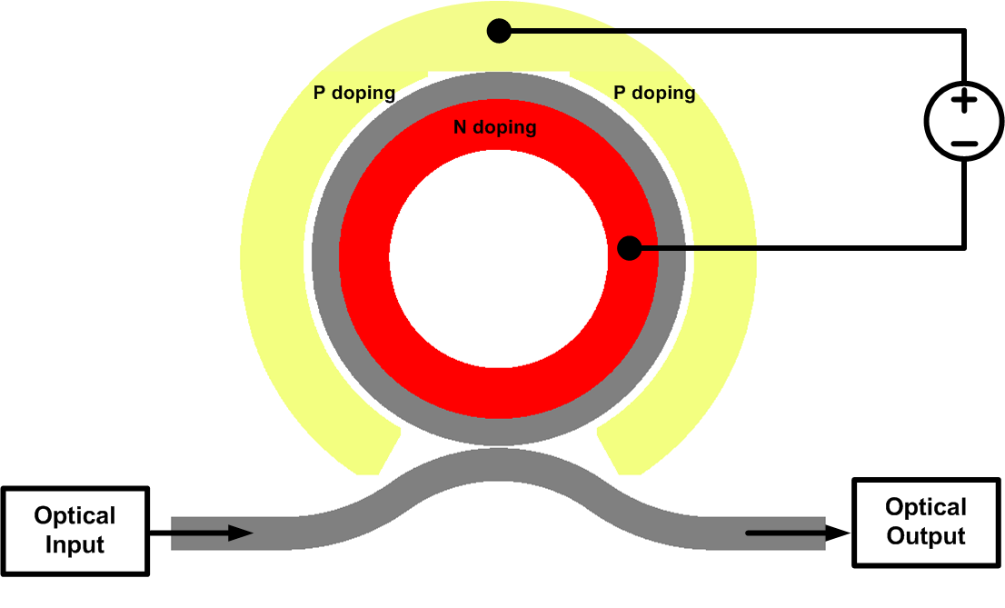
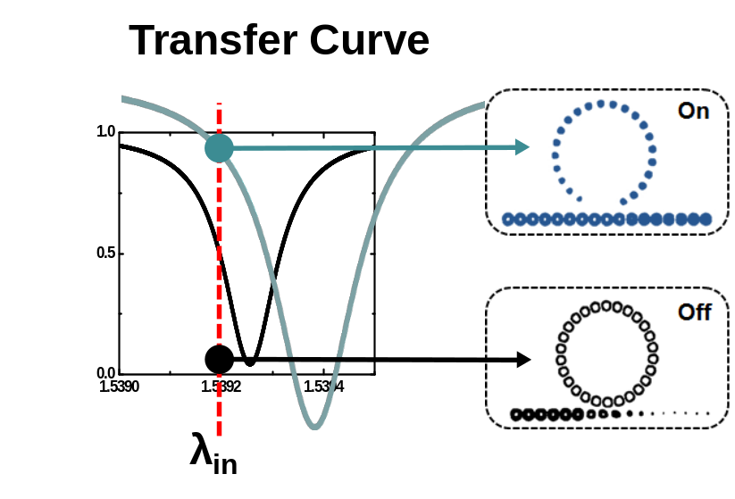
Device Structure
Voltage change
➔ Refractive index change
➔ Transfer Curve Change
➔ Modulation

Slide 7
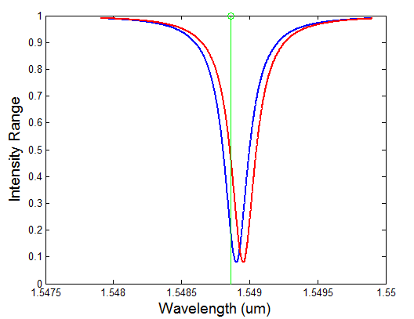
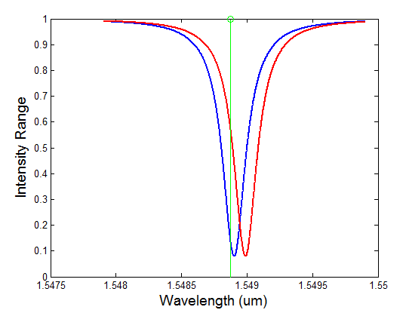


Effects on optical modulation amplitude
1. Tunability
12μm
12μm
Refractive index change per voltage
Doping concentration effects

Slide 8
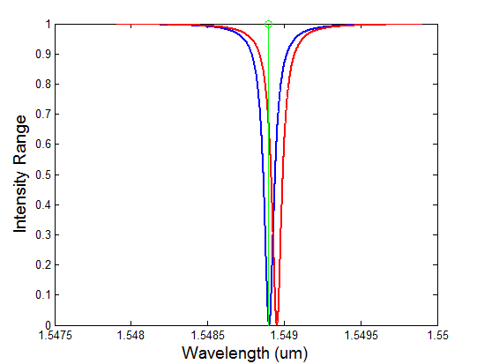
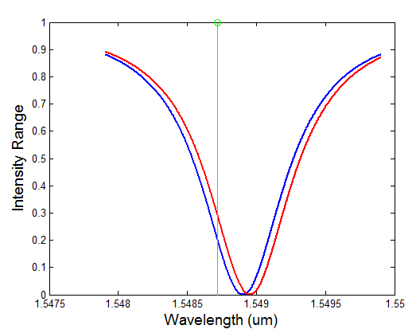


Effects on optical modulation amplitude
2. Quality Factor
12μm
12μm
Shape of transfer curve
α, γ, radius effects to Q factor

Slide 9
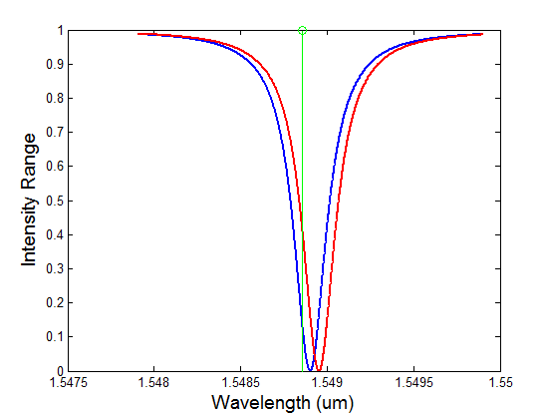
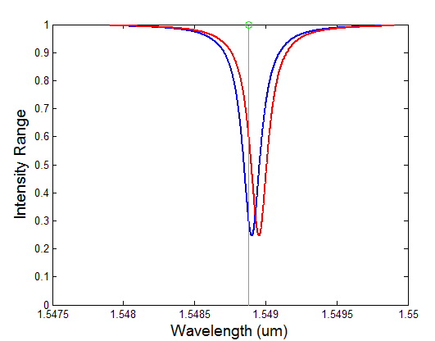
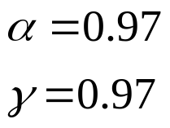
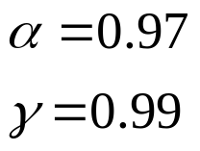
Effects on optical modulation amplitude
3. Coupling state
12μm
12μm

Slide 10
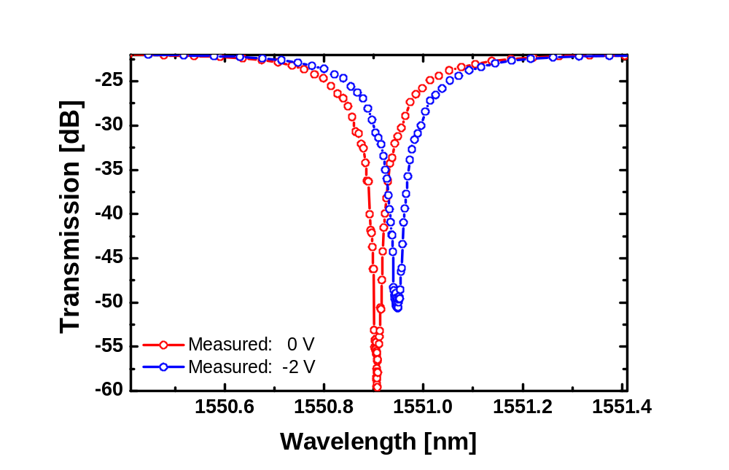
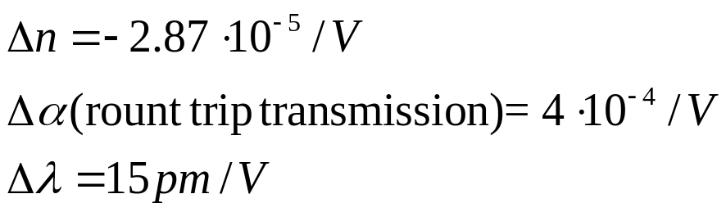
DC –characteristic curve
P: 7E17 N: 3E18
Gap: 250 nm
Radius 12 μm
(α,γ) (0.9731,0.9731)
(0.9735,0.9731)

Slide 11
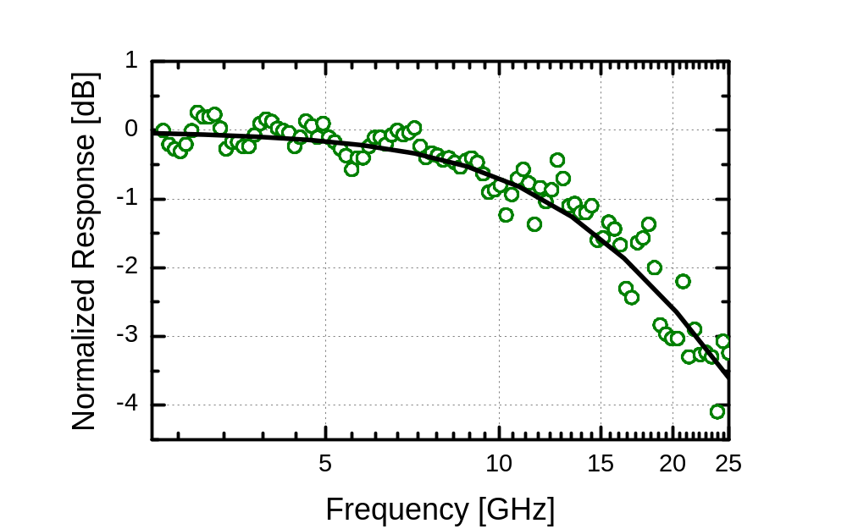
AC response
Frequency response
Specification of modulator
High bandwidth enable to send high data rate

Slide 12
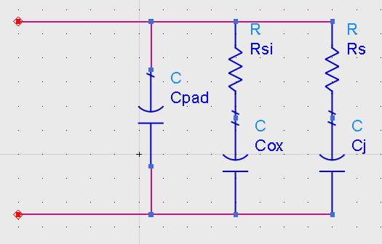
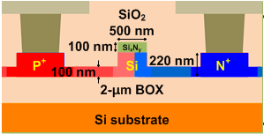
Effects on optical modulation amplitude
Electrical bandwidth
RC component by parasitic value and junction capacitance
Energy/bit = ¼ CV²

Slide 13
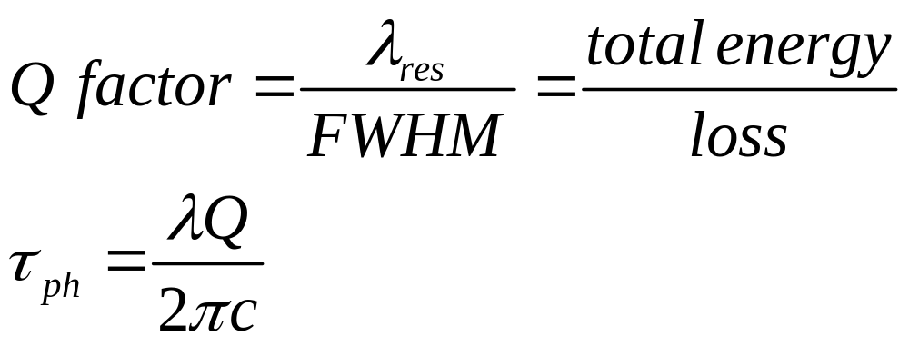
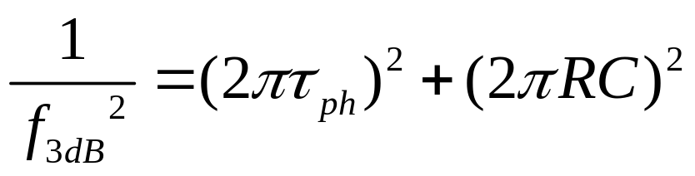
Effects on optical modulation amplitude
Photon life time
Frequency Response
Photon lifetime
Electric Effect

